Slide 1
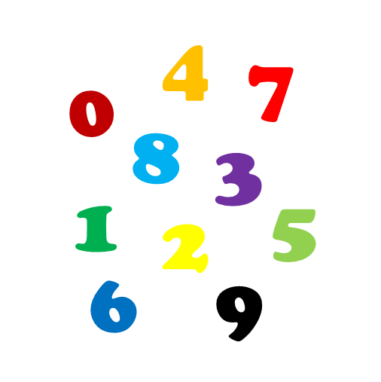
Basic Concepts of Epidemiology – Part 2
Nina Gunnes
September 10, 2020

Slide 2
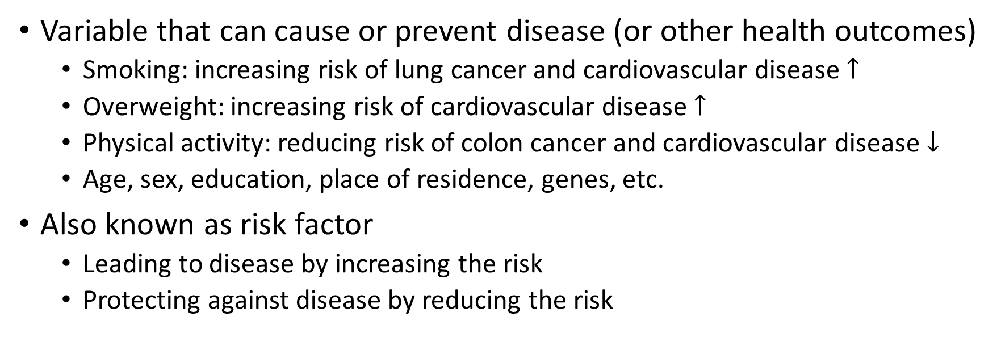
Exposure
Variable that can cause or prevent disease (or other health outcomes)
  Smoking: increasing risk of lung cancer and cardiovascular disease $↑$
  Overweight: increasing risk of cardiovascular disease $↑$
  Physical activity: reducing risk of colon cancer and cardiovascular disease $↓$
  Age, sex, education, place of residence, genes, etc.
Also known as risk factor
  Leading to disease by increasing the risk
  Protecting against disease by reducing the risk

Slide 3
Confounder
Also known as a confounding variable
Common cause of the exposure and the outcome
Could confounding have influenced the study findings?
  People rarely exposed to one risk factor alone
Association between diet and lung cancer confounded by smoking
  Usually a stronger association when smoking is not taken into account
  Diet potentially differing between smokers and non-smokers
  Smoking increasing the risk of lung cancer

Slide 4
Confounder, cont.
Smoking (confounder)
Diet (exposure)
Lung cancer (outcome)

Slide 5
Confounder, cont.
Must always consider confounding
Confounding not taken into account giving rise to erroneous results
  Too strong or too weak associations
  Spurious associations
  Undetected associations
Age being a common confounder in epidemiological studies
  Age-standardized incidence rates in population statistics
  Taken into account when estimating exposure-outcome association

Slide 6




Confounder, cont.
Take $C$ into account in the analysis
  Adjustment
  Stratification
  Standardization
  …
$$C$$
$$E$$
$$O$$

Slide 7
Multivariable statistical methods
Also known as multiple statistical methods
Involving multiple independent variables (predictors)
  Exposures, confounders, etc.
Method depending on study design and types of variables included
  Multiple linear regression
  Multiple logistic regression
  Multiple Cox regression
  Multiple Poisson regression

Slide 8
Example 10.4 in Aalen et al. (2006)
Folate supplementation and twin pregnancies (Vollset et al., 2005)
  Data from the Medical Birth Registry of Norway
  Births from December 1998 through the end of 2001
  Preconceptional use of folate and multivitamin supplements
 | Folate use | No folate | Total
Twin pregnancy | 329 | 2,825 | 3,154
Singleton pregnancy | 10,748 | 162,140 | 172,888
Total | 11,077 | 164,965 | 176,042

Slide 9
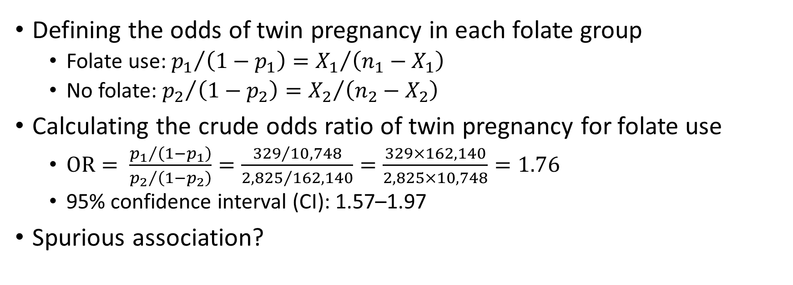
Example 10.4 in Aalen et al. (2006), cont.
Defining the odds of twin pregnancy in each folate group
  Folate use: ${p_{1}}/{\left(1−p_{1}\right)={X_{1}}/{\left(n_{1}−X_{1}\right)}}$
  No folate: ${p_{2}}/{\left(1−p_{2}\right)={X_{2}}/{\left(n_{2}−X_{2}\right)}}$
Calculating the crude odds ratio of twin pregnancy for folate use
  $\text{OR}= \frac{{p_{1}}/{\left(1−p_{1}\right)}}{{p_{2}}/{\left(1−p_{2}\right)}}=\frac{{329}/{10,748}}{{2,825}/{162,140}}=\frac{329×162,140}{2,825×10,748}=1.76$
  95% confidence interval (CI): 1.57–1.97
Spurious association?

Slide 10
Example 10.4 in Aalen et al. (2006), cont.
1.5% of pregnancies resulting from in vitro fertilization (IVF)
Higher proportion of twin pregnancies after IVF
  Natural conception: 1.4%
  IVF: 27%
Use of folate 4 times as frequent among women conceived by IVF
  Natural conception: 6.0%
  IVF: 24%
Confounding by IVF?

Slide 11
Example 10.4 in Aalen et al. (2006), cont.
IVF
IVF
IVF
Folate use
Twinning
Maternal age
Maternal age
Maternal age
Parity
Parity
Parity

Slide 12
Example 10.4 in Aalen et al. (2006), cont.
Adjusting for potential confounders using logistic regression
  Maternal age and parity: OR = 1.59 (95% CI: 1.41–1.78)
  Maternal age, parity, and IVF: OR = 1.04 (95% CI: 0.91–1.18)
No evidence of association between folate use and twinning
  Association strongly confounded by IVF

Slide 13

Collider
Common effect of exposure and outcome
Do not take $C$ into account in the analysis
  May cause selection bias
$$C$$
$$E$$
$$O$$

Slide 14
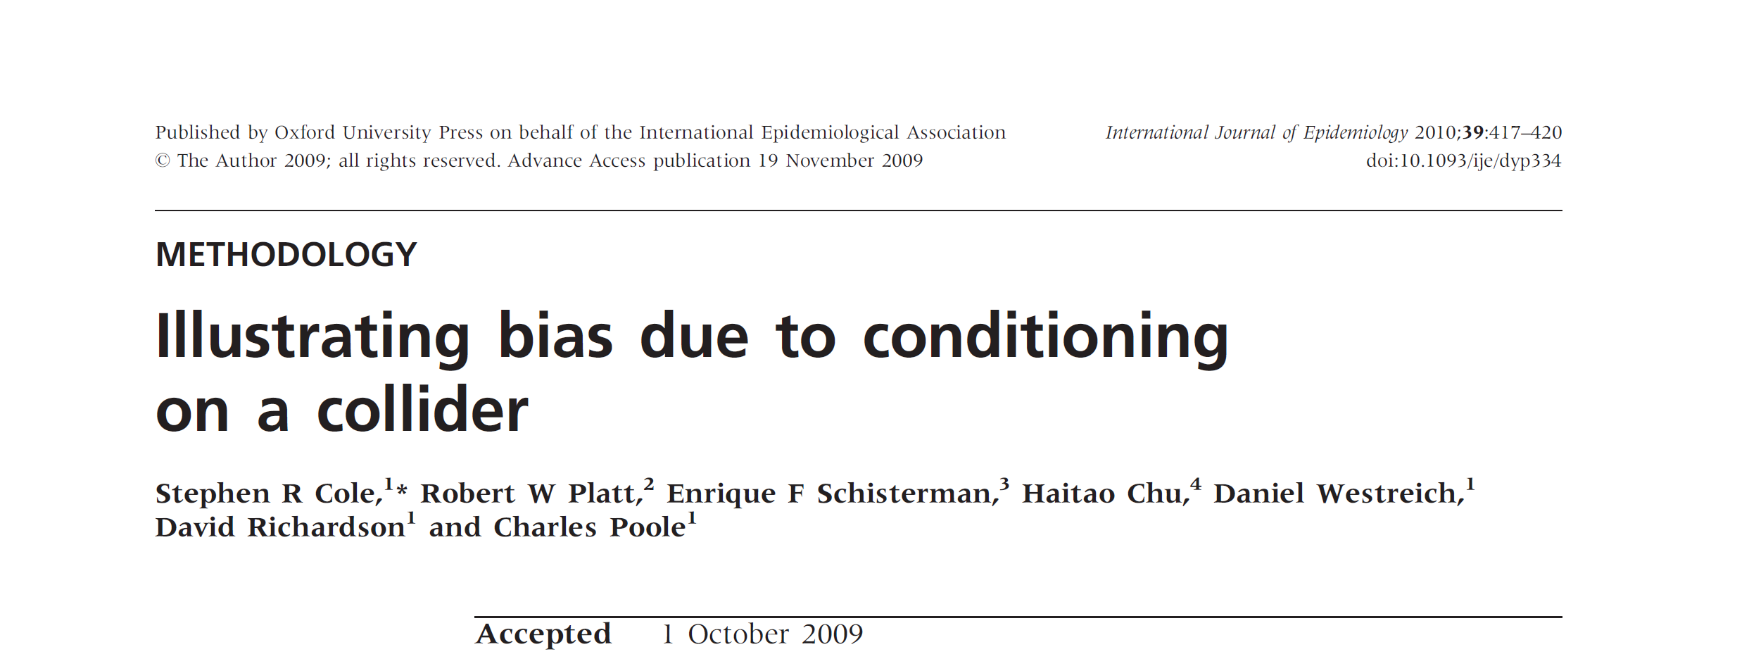
Collider, cont.

Slide 15
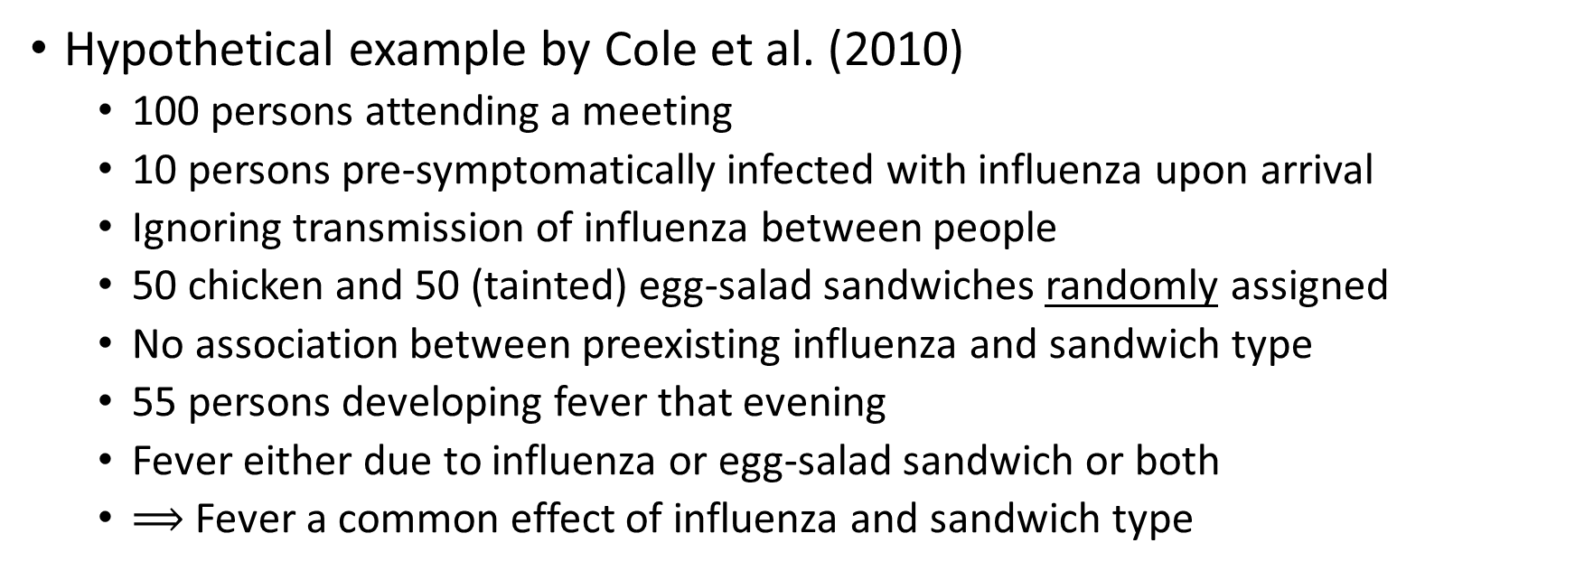
Collider, cont.
Hypothetical example by Cole et al. (2010)
  100 persons attending a meeting
  10 persons pre-symptomatically infected with influenza upon arrival
  Ignoring transmission of influenza between people
  50 chicken and 50 (tainted) egg-salad sandwiches randomly assigned
  No association between preexisting influenza and sandwich type
  55 persons developing fever that evening
  Fever either due to influenza or egg-salad sandwich or both
  $⟹$ Fever a common effect of influenza and sandwich type

Slide 16
Collider, cont.
Influenza
Sandwich type
Fever
Based on Figure 1 in Cole et al. (2010)

Slide 17
Collider, cont.
 | Influenza
 | Yes | No | Total | Risk | Risk difference
Unconditioned
Chicken sandwich | 5 | 45 | 50 | 0.1 | 0.0
Egg-salad sandwich | 5 | 45 | 50 | 0.1
Conditioned
Fever
Chicken sandwich | 5 | 0 | 5 | 1.0 | 0.9
Egg-salad sandwich | 5 | 45 | 50 | 0.1
No fever
Chicken sandwich | 0 | 45 | 45 | 0.0 | NA
Egg-salad sandwich | 0 | 0 | 0 | NA
Based on Table 1 in Cole et al. (2010)

Slide 18


Mediator
On the causal pathway between the exposure and the outcome
Direct effect of $E$ on $O$
  Take $M$ into account in the analysis
Total effect of $E$ on $O$
  Do not take $M$ into account in the analysis
$$M$$
Indirect causal path
$$E$$
Direct causal path
$$O$$

Slide 19
References
Aalen OO, Frigessi A, Moger TA, Scheel I, Skovlund E, Veierød MB. 2006. Statistiske metoder i medisin og helsefag. Oslo: Gyldendal akademisk.
Cole SR, Platt RW, Schisterman EF, Chu H, Westreich D, Richardson D, Poole C. Illustrating bias due to conditioning on a collider. Int J Epidemiol. 2010 Apr;39(2):417-20. doi: 10.1093/ije/dyp334. Epub 2009 Nov 19. PMID: 19926667; PMCID: PMC2846442.
Stian Lydersen. Effect Modification and Mediation. October 6, 2017. Updated September 8, 2020. http://folk.ntnu.no/slyderse/medstat/Effectmod_mediation_6Oct2017.pdf. Accessed September 9, 2020.
Vollset SE, Gjessing HK, Tandberg A, et al. Folate supplementation and twin pregnancies. Epidemiology. 2005;16(2):201-205. doi:10.1097/01.ede.0000152914.84962.13.
Zarghooni S. Sjokolade og fotball som medierende variabler i et kjærlighetsforhold. Lærelogg: Masterstudier i arbeids- og organisasjonspsykologi. 2010. https://zarghooni.wordpress.com/2010/12/26/sjokolade-og-fotball-som-medierende-variabler-i-et-kjaerlighetsforhold/. Accessed September 9, 2020.

